Slide 1
Group Project RIL
Group Members:
Aakash Kumar-J004
Yash Dalal-J008
Aadityaharan Ganesh-J014
Rishabh Jain-J021
Manas Tokale-J053

Slide 2
Index
Sr.No | Title
1 | Project Description
2 | Data Before And After Cleaning
3 | R Code
4 | Interpreting Results
5 | Accuracy Of Model

Slide 3
Aim: To Find all the factors affecting Deviation Cost in the shipping of Polyester
Data taken from: Polyester Exports Department of RIL
Method used: Non-Linear Regression
Can be used to predict future Deviation Costs of other materials too ,if relevant data is provided

Slide 4
Variable Description
NO OF CNTRS : Number of containers of a particular material on a particular day at a particular port.
Container Type : Types of Containers - 20 DV and 40 HC having different sizes, volumes.
Port of Destination : It is the location to where the cargo/material is transported/exported.
Dispatch Quantity : The quantity that was dispatched in the container in metric tons.
TRANSIT TIME AS PER RFQ : The agreed transit time as per the freight contract between reliance industries Limited and the Shipping company that transports the material. RFQ - Reliance freight Quote.
Selection of SH.line : The shipping line category selected to transport the load from source to destination.

Slide 5
Variable Description
Stuffing Remarks : The state of the container - completely stuffed or not.
Actual POL : Location where the container is filled/stuffed and transported from. (All these ports are in India.)
Shipping line: This tells us about the company that helps transport the material from point A to point B
Dev Cost: It is the difference between the freight charge of the selected shipping line category and the shipping line category with the minimum freight charge.
Country: Country in which the destination port is located.
Sector: Maritime sector in which the destination port is located.

Slide 6
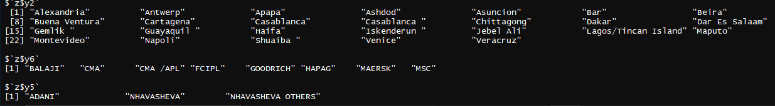
Levels in independent variables
Y2←PORT OF DESTINATION
Y5←LOCATION OF LOADING/ALL ARE LOCATED IN INDIA
Y6←SHIPPING LINE

Slide 7
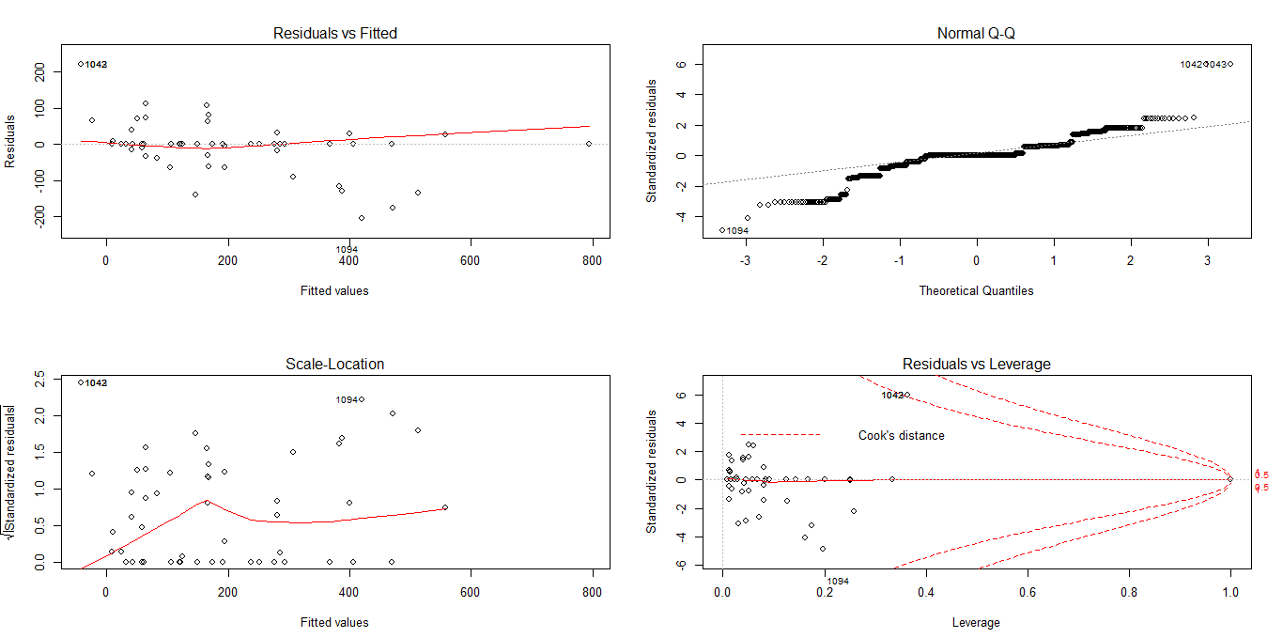
Plots

Slide 8


Residual Standard Error here is estimate of the accuracy of the Deviation Cost being measured.
This Model is almost 92% as is evident from the Multiple R Square which gives us percentage of the response variable variation that is explained by a linear model.
Adjusted R Square here adjusts the statistic based on the number of independent variables in the model.(i.e. 11)
Dim function returns the dimension (e.g. the number of columns and rows) of a matrix, array or data frame.
Interaction Effect/VIF is not significant in this case and the code described in this presentation is the final one with all the significant lines of code.

